Slide 1
Best Practice / Technical Update Intercept Sept 09
Simon Townsend
Head of Pre Sales / Systems Engineering

Slide 2
Agenda
Recap and Demonstration of UEM
Common Questions
EM SP1 and SP2 Update
Best Practice
EM Policy and EM Personalisation
Troubleshooting
Arhitecture, Scalability and Multi Site
Streamed “Provisioned OS”
Streamed Applications
PM Update
Default Configuration
Statistics
AM Update
Default Configuration
ANAC
Other resources

Slide 3
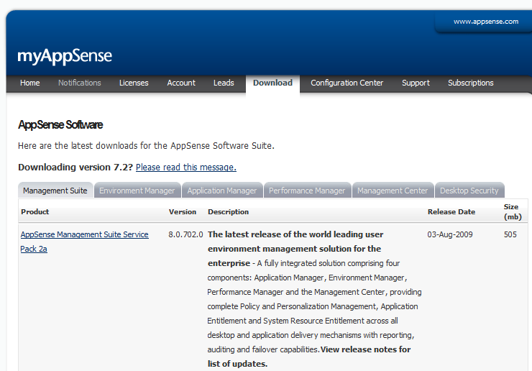
Latest Versions
AppSense Management Suite SP2a
Released 3rd August 2009
Suite Version 8.0.702.0
Available from www.myappsense.com

Slide 4
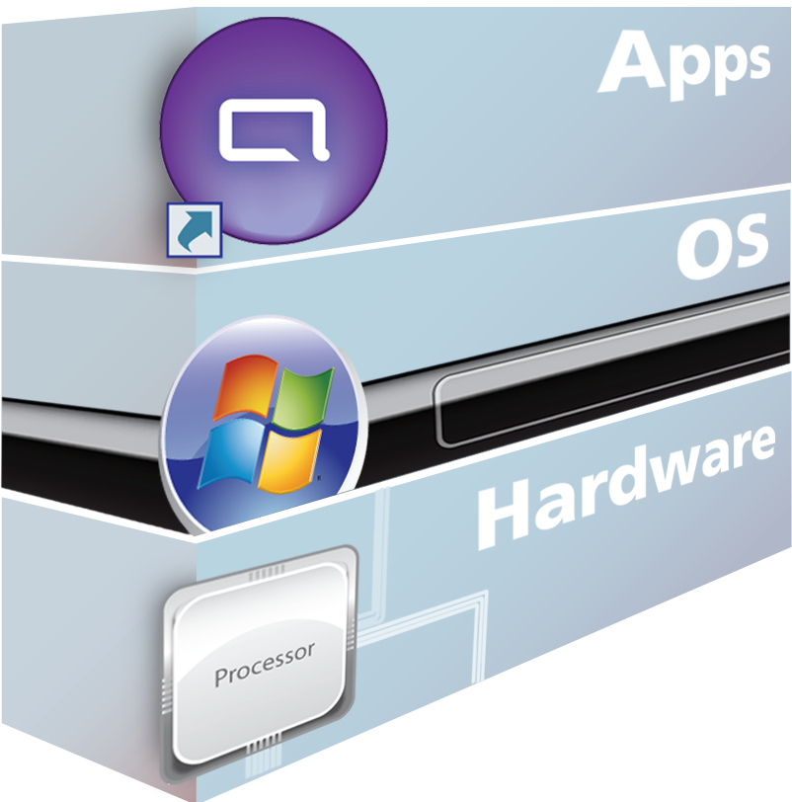
Virtualization in Client Computing

Slide 5
Virtualization in Client Computing

Slide 6
Virtualization in Client Computing

Slide 7
Virtualization in Client Computing
User Personality

Slide 8
The Third Layer – User Personality

Slide 9
The User Personality
Policy
Set up and maintain a desktop
Personalization
Enable the user to
make it their desktop

Slide 10
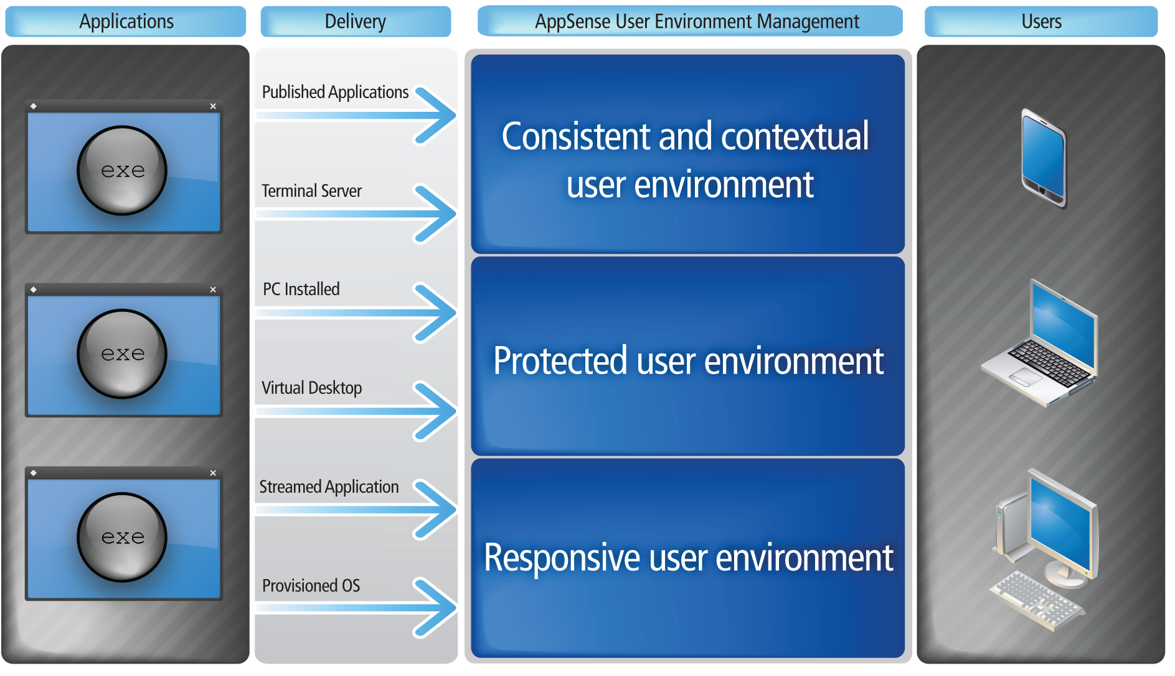
Introducing user environment management

Slide 11
user environment management Solution
AppSense user environment management
AppSense Management Suite
Consistent and contextual user environment
Policy and Personalization
Management
Protected user environment
Application
Entitlement
Responsive user environment
Resource
Entitlement

Slide 12
AppSense Solution Set
W2K3, W2K8, Windows XP and Vista
All 32bit and 64bit
Both consoles and Agents

Slide 13
A complete solution
Personalization and Policy Management
Faster user logon times
Reduce profile corruption & support call remediation
Replacement of complex logon scripts
Application Entitlement
Deny unauthorised executables
Control authorised application usage
Reduce Microsoft application licence requirements
System Resource Management
More users per server / server consolidation
Improved quality of service / prevent server lockups
Extend hardware lifecycle
Notes:
During good times, cost reduction is not always top of mind for many organizations. However, during economic downturn or recessions, we hear the request to “do more with less” from management way more frequently. Many Citrix customers are not aware of the optional cost savings that you have within your environments today. Cost savings will vary from organization to organization, but I can safely assume that many of you in the audience have opportunity to save your company money through infrastructure cost savings, improved automation and management, user productivity savings, and IT staff efficiencies. Here are just a few cost savings associated with user environment management.
Faster logon times
Reduce profile corruption
Fewer “gold” images to manage
Avoid unused licenses
Increase the number of Citrix users per server
Avoid support and end user impact for server lockup issues
(70-90 seconds)

Slide 14
Demo

Slide 15
Some Basics

Slide 16
Some Basics
The AMC
W2K3, IIS, BITS, HTTP(s)
The Agents
MSI
The Config’s
XML, Packaged as MSI, can be saved in A**P format (zip)
Deployment Groups
Directory vs Computer

Slide 17
Manual Installation of CCA
Deployment Options
SCCM, Altiris, GPO, AppSense Deployment Tool,
msiexec.exe /qn /i "<MSI file path>\CommunicationsAgent.msi" WEB_SITE="https://<Management Server Name>" GROUP_NAME="<DeploymentGroup>"

Slide 18
AppSense Environment Manager
Sp1 and Sp2 Update

Slide 19
AppSense Environment Manager 8.0 SP1
Policy Configuration
Override Personalization option on Process Start nodes
Automated Desktop Settings Refresh on Policy Configuration Triggers
Microsoft App-V support Policy Configuration
Reusable conditions in reusable nodes
Performance enhancements

Slide 20
AppSense Environment Manager 8.0 SP1
User Personalization
Microsoft App-V support for User Personalization
Discover All Processes mode (passive monitoring)
Personalization Analysis improvements
Ability to disable Desktop Settings per Personalization Group
Ability to move users between Personalization Groups
Large performance enhancements

Slide 21
AppSense Environment Manager 8.0 SP2
Policy Configuration
Stop condition for controlling action and node execution
Run As User Action
Highlight nodes that make use of reusable nodes
Exclusions for Registry Hiving actions
Process name condition to allows wildcards and parameters
Run Once option
Auditing action to record user logon duration

Slide 22
AppSense Environment Manager 8.0 SP2
User Personalisation
Active Directory Site Condition for Personalization Settings
Delete client side caches
Global Properties Editor
Manipulate files in User Personalization cache
User Created Application White list

Slide 23
Demo

Slide 24
AppSense Environment Manager
Policy – Best Practice

Slide 25
AppSense Environment Manager Policy - Goals
Reduce user logon times
Configuration and Agent run locally on client.
XML configuration allow parallel processing
Centralise management of scripts and group policies
Actions typcially done in scripts are done via EM
GPO Administrative Templates managed in the same console.
Version control of policy allows controlled deployments and configuration.
Provide increased granular control

Slide 26
AppSense Environment Manager Policy - Basics
Configuration is made up of
Nodes – containers for conditions and actions
Actions – applied to the user to manipulate their environment.
Conditions – control which situations actions should be applied

Slide 27
AppSense Environment Manager Policy - Nodes
Sibling Nodes
Run Synchronously

Slide 28
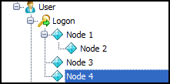
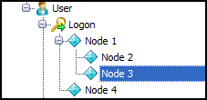
AppSense Environment Manager Policy - Nodes
Parent and Child Nodes
Child will not execute until it’s parent has completed
Stop If Fails is the replacement for the dependency of functionality of v7.x

Slide 29
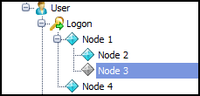
AppSense Environment Manager Policy - Nodes
Disable Nodes
Achieved by “Toggle State” functionality

Slide 30
AppSense Environment Manager Policy - Actions
Execution Order
Actions will be run synchronously
Folder Action will execute after Drive Mapping has completed.
Drive and Registry action will run sychronously

Slide 31
AppSense Environment Manager Policy – Conditions
Conditions are essentially IF statements.
They be set as a single condition
They be set as an AND condition

Slide 32
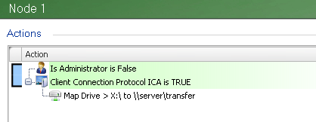
Appsense Environment Manager Policy - Conditions
They can be set as an OR condition

Slide 33
AppSense Environment Manager Policy – Actions + Conditions
Actions are placed underneath Conditions
This makes the action execution dependant on the condition being true.

Slide 34
AppSense Environment Manager Policy – Reusable Nodes and Conditions
Allows you to build up a library of Actions and Conditions within nodes that can be reused.
Speeds up time to complete configurations.

Slide 35
AppSense Environment Manager Policy – Best Practices
Group like actions together synchronously
The more that can be parallel processed the less time for Environment Manager to run.
Use Environment Manager native actions where possible
Relying heavily on custom actions / conditions and execute actions can degrade Environment Manager performance.
Run Actions only when required
Why map a drive for an application at logon when you can do it when the application is started.
Removes overhead on the logon process

Slide 36
AppSense Environment Manager Policy – Best Practices
Where possible used Group Policy ADM’s within Environment Manager
Reduces the negative effect GPO’s can have on logon by being delivered by Active Directory
Copy Shortcuts rather than creating them.
Reduces Environment Manager execution time.
Make use of Environment Variables
Makes your configuration portable
Make use Session reconnect within XenApp
Can evaluate your users when they move locations.

Slide 37
AppSense Environment Manager Policy – Best Practices
Don’t use custom conditions within Reusable Conditions.
Environment Manager will evaluate the condition twice in this configuration.

Slide 38
How works User Personalization
New Pre Sales Doc\Tech Ref EMPS Transactions.docx

Slide 39
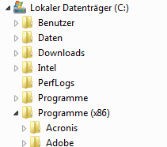
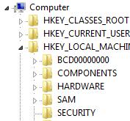
How works User Personalization (write)
Sample.docx
User.dic
Reg value in HKCU\Software
Only Profile Information’s:
HKCU\Software
C:\Documents & Settings
Filter
File System
Registry
AppSense Virtual Cache

Slide 40
How works User Personalization (read)
Sample.docx
User.dic
Reg value in HKCU\Software
Only Profile Information’s:
HKCU\Software
C:\Documents & Settings
Filter
File System
Registry
Sample.docx
AppSense Virtual Cache
User.dic
Reg value in HKCU\Software

Slide 41
How works User Personalization (read) Missing file in AppSense Virtual Cache
User.dic
Only Profile Information’s:
HKCU\Software
C:\Documents & Settings
Filter
File System
Registry
Sample.docx
User.dic
AppSense Virtual Cache
Reg value in HKCU\Software

Slide 42
How works User Personalization (read) Two Application & One User Setting File
User.dic
Filter
File System
Registry
User.dic
AppSense Virtual Cache for WINWORD.EXE
AppSense Virtual Cache for OUTLOOK.EXE
User.dic

Slide 43
How works User Personalization (read) Two Application & One User Setting File (Application Group)
Personalization Application Group
Filter
File System
Registry
AppSense Virtual Cache
For WINWORD.EXE and OUTLOOK.EXE
AppSense Virtual Cache for WINWORD.EXE
AppSense Virtual Cache for OUTLOOK.EXE
User.dic
User.dic

Slide 44
How works User Personalization (Migration Mode) During Read Process
User.dic
Only Profile Information’s:
HKCU\Software
C:\Documents & Settings
Filter
File System
Registry
User.dic
User.dic
AppSense Virtual Cache

Slide 45
AppSense Environment Manager
Personalisation – Best Practice

Slide 46
EM Personalisation Server - Best Practice
Creating Personalization Groups
Personalization Group Settings
Manually creating Applications and Application Groups
Discover and convert Applications to Whitelist
White Listing Applications
Desktop Settings
Outlook Best Practice
Reg Keys, Desktop Settings and Application Grouping
When to use offline mode

Slide 47
Enabling User Personalization
Single or multiple Personalization Servers can be added
It is recommended multiple Personalization Servers are added here (where applicable) for failover purposes:

Slide 48
Enabling User Personalization
The list of Personalization Servers is queried from the top down
If communication with the 1st Personalization Server in the list is successful, the ProfileConfig.xml file is downloaded via this Server
If the 1st Personalization Server in the list is unavailable then the next Server in the list is contacted until successful communication is achieved
If the list is exhausted then the ProfileConfig.xml file is not downloaded and no Personalization will take place
It is recommended that the following auditing event be enabled to monitor this:
Event 9661 – Timeout Communicating with Personalization Server

Slide 49
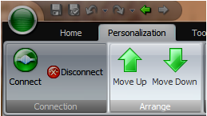
Personalization Group Usage
Personalization Groups allows different personalization settings to be applied to users based on membership rules
A user may be a member of more than one Personalization Group
The user is assigned to the first Personalization Group in the list where the membership rule is valid
Personalization Groups can be ordered in the list by means of the Move Up and Move Down Personalization ribbon options

Slide 50
Personalization Group Usage
It is recommended that Personalization Groups be ordered in terms of importance to ensure that your users are assigned to the more relevant Personalization Group
The Default Users Personalization Group is used as the catch-all group should none of the membership rules be passed in any of the other Personalization Groups
This is always located at the bottom of the Personalization Groups list and cannot be moved up or down

Slide 51
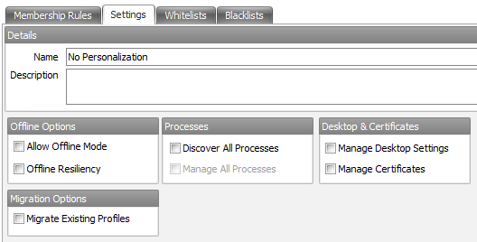
Excluding Users from User Personalization
To exclude a user from User Personalization each option on the Settings tab of the chosen Personalization Group will need to be disabled:
You must then add the relevant membership rules to the Personalization Group to include the users or computers you wish to exclude

Slide 52
Moving Users Between Personalization Groups
Personalization settings cannot currently be shared between Personalization Groups
If you need to move a user’s settings to another Personalization Group this can now be done via Personalization Analysis
This is achieved by running up a Personalization Analysis report, By user, from either the Size, Whitelist Application Usage or Discovered Application Usage reports

Slide 53
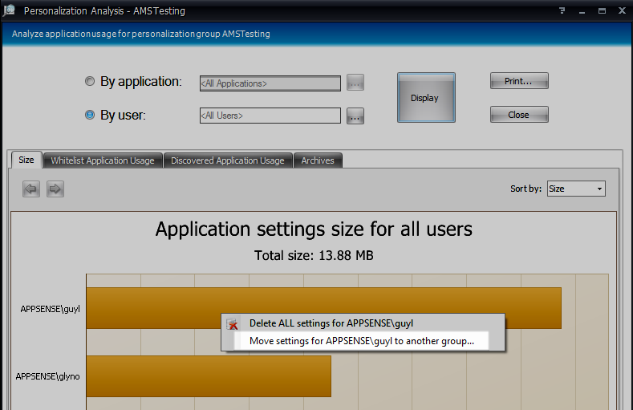
Moving Users Between Personalization Group
Select the user you wish to move
Right click and choose ‘Move settings for <user> to another group…’:

Slide 54
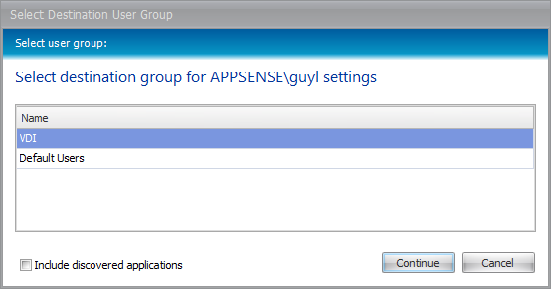
Moving Users Between Personalization Groups
This will prompt the administrator to choose another available group to move the chosen user’s personalization settings to:
‘Include discovered applications’ (off by default) moves discovered applications too
It is recommended this also be checked

Slide 55
Personalization Server – Application Groups
Placing applications into the same group means that applications can be managed and streamed as one.
Very useful to Group Outlook and Winword together as they are closely linked
When the user launches Outlook.exe, both Outlook and Word profile settings will be pulled down to the client
Disadvantage means that these applications must be “rolled back“ together
Examples of this are:
Internet Explorer and IEUser.exe
MSN Messenger and SimpLite

Slide 56
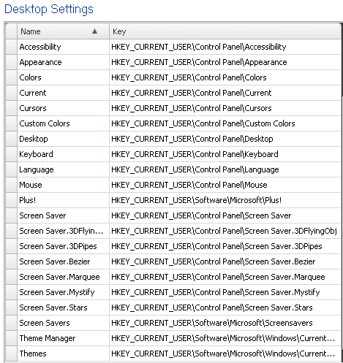
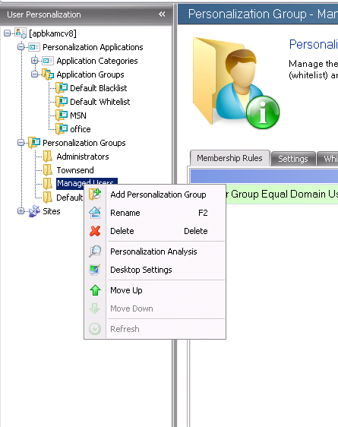
Personalization Server – Desktop Settings
Desktop Settings
Keys are imported to the real registry at logon, and exported from the real registry at logoff. They contain all the information regarding the desktop, wallpaper, mouse keys, keyboard settings, etc. Keys listed must be present on the OS before these can be imported. Desktop settings can be accessed and viewed through the Profile Analysis tool

Slide 57
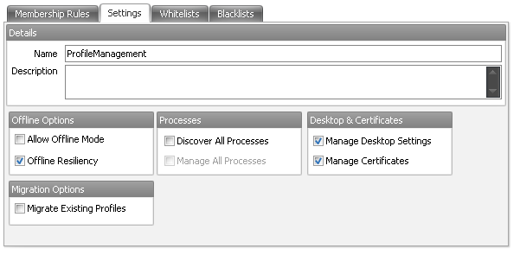
AppSense Personalization Server - Configuration
Personalization Group - Settings

Slide 58
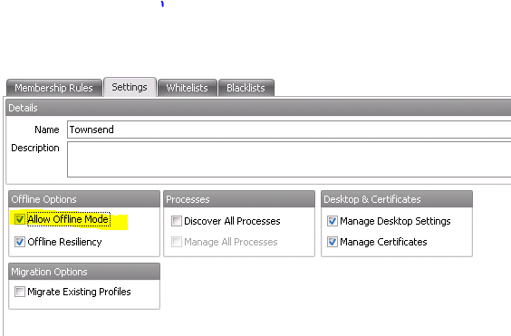
Allow Offline Mode
Allow Offline Mode is off by default
This enables mobile users to still have access to their personalization settings whilst off the corporate network
By enabling this option, a local copy of the virtual personalization cache is retained on the managed endpoint device when the user logs off
It is recommended this option only be switched on for managed endpoints that are mobile, i.e. laptops, notebooks etc..

Slide 59
Offline Resiliency
Offline Resiliency is on by default
It is recommended this setting remains enabled
Ensures if communication between the managed endpoint and the database is lost, synchronization of personalization data is re-attempted until communication is re-established

Slide 60
Discover All Processes
Discover All Processes is off by default
A ‘passive monitoring’ mode which allows managed endpoints to be monitored for launched applications
Each application a user launches is ‘discovered’ and recorded so that, at a later date, it can either be added to a whitelist, blacklist or deleted
It is recommended that ‘Discover All Processes’ is switched on so that applications being used by users can be identified

Slide 61
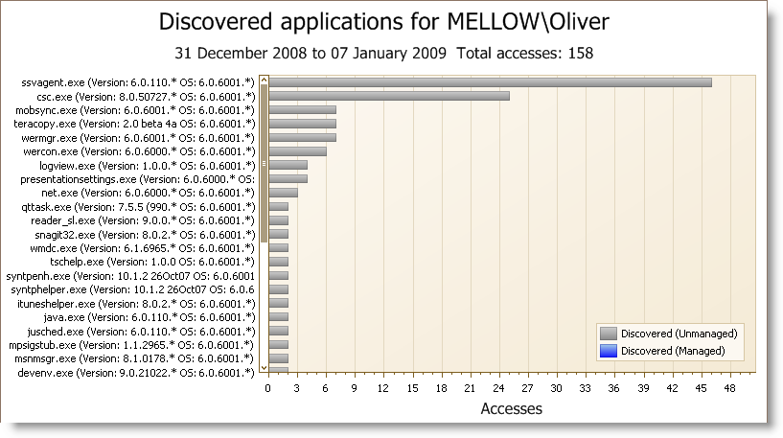
Discover All Processes
Personalization Analysis reports can be run that show applications discovered by the ‘Discover All Processes’ option:
It is recommended that discovered applications are then converted to Whitelisted applications where required.

Slide 62
Manage All Processes
Manage All Processes is off by default
The ‘Manage All Processes’ option is now a sub option of the ‘Discover All Processes’ option and can only be enabled if ‘Discover All Processes’ is also enabled
It is not recommended that this option be used in a live environment for long periods of time
It is recommended that this option be used in a pilot environment to identify applications and also prove that they can be personalized without issue

Slide 63
Whitelist and Blacklist
It is recommended that a Whitelist be utilized along with ‘Discover All Processes’
This allows only a specific set of user applications to be personalized
Add user configurable applications to the whitelist such as MS Office Applications, Web Browsers, instant messaging applications etc..
Any applications added to a Blacklist will not be managed
Exclude ‘utility’ applications such as compression software, anti-virus and system tools from being personalized.

Slide 64
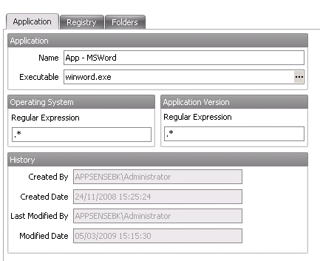
Personalization Server – Creating Applications
Using .* means that all OS types can be used
EM will capture all instances of this app across multi platform
Using a .* will allow all versions of the application to be captured in the same profile.
If you want to manage different versions of an application separately, then use the boxes to edit the .*

Slide 65
Application Groups
Application Groups are recommended when one application relies on another applications settings
Examples of this are:
Internet Explorer and IEUser.exe
MSN Messenger and SimpLite

Slide 66
Manage Desktop Settings
Manage Desktop Settings is on by default
Globally configured from Desktop Settings on the Tools Ribbon
Now enabled on a per Personalization Group basis
Recommended Manage Desktop Settings only be enabled for Personalization Groups for which the desktop settings need to roam

Slide 67
Manage Certificates
Manage Certificates is on by default
Enabling this option instigates ‘profile state emulation’ whereby the operating system is fooled into thinking the user is logged in with a roaming profile
It is recommended that this option be disabled on Personalization Groups where the members of that group are not utilizing a mandatory profile

Slide 68
Migrate Existing Profiles
Migrate Existing Profiles is off by default
Migrate Existing Profiles utilizes a ‘Virtualize-on-Read’ technique
Recommended when:
migrating users from local or roaming profiles
migrating from one OS to another
This option should be disabled once all users have launched each application to be personalized
This can be ascertained from the Whitelist Application Report

Slide 69
Sites
For organizations with concentrations of geographically dispersed users
The primary site should be installed where the largest user base is located
This becomes the Default Site listed under the Sites list
Branch sites can be added by installing Personalization Servers at other locations
Users retrieve their ProfileConfig.xml from the first Personalization Server contactable as detailed in the configuration.aemp file
Subsequent synchronizations will then occur via the designated Site based on the membership rules assigned to the Sites

Slide 70
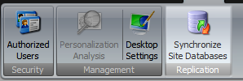
Database Replication & Synchronization
Where multiple databases are required (for failover support or to support geographically dispersed locations) replication can be configured
See the AppSense Environment Manager Administration Guide
When configured this replication will occur once per day by default
It is recommended that the ‘Synchronize Site Databases’ option be utilized if replication between databases is required immediately:

Slide 71
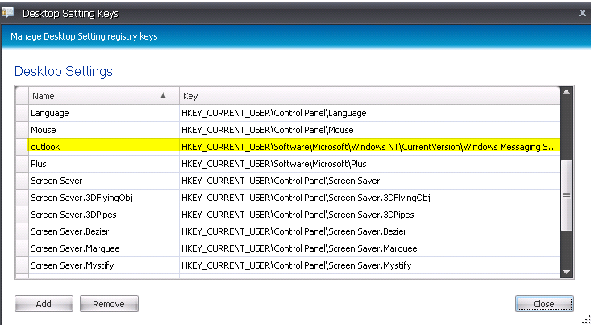
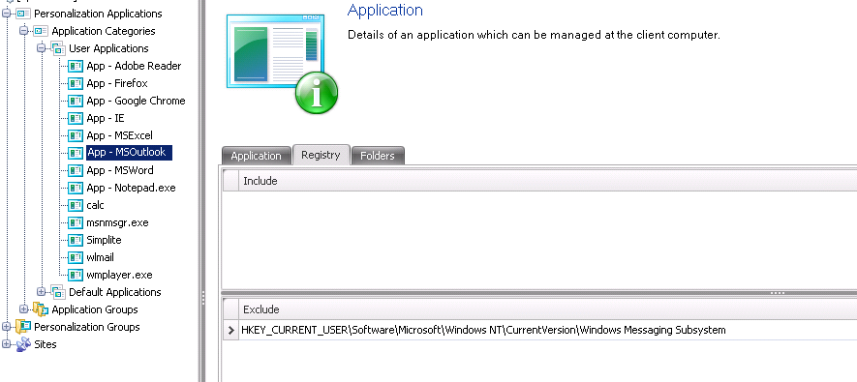
Best Practice Microsoft Outlook
“Send To” and “Mail Configuration in Control Panel” Make sure the following key is present in either the default.dat or the NTUser.MAN that the user is using when they logon
HKCU\Software\Microsoft\Windows NT\CurrentVersion\Windows Messaging Subsystem
This would just be the KEY with NO DATA in it
Tell AppSense not to vitalize the key required by both Outlook
HKCU\Software\Microsoft\Windows NT\CurrentVersion\Windows Messaging Subsystem key should be added as an exclusion on the Outlook.exe process under the personalised Applications section.
Then tell AppSense to import and export the same key into the real registry and logon and logoff
This is achieved by Adding HKCU\Software\Microsoft\Windows NT\CurrentVersion\Windows Messaging Subsystem in the “desktop settings” section of the EM Personalisation server console. This key will in effect be delivered along with any other desktop settings such as certs, wallpaper etc

Slide 72
Troubleshooting EM policy

Slide 73
Troubleshooting
Check licence!
Confirm machine has been deployed to.
Confirm correct packages
Confirm “use latest is enabled”
Check add remove programs on client machine
Check Task Manager on client machine and confirm EMAgent is running
Check the services tab and make sure that both AppSense Environment Manager Agent and EM Notify Services are enabled and started.
Check Task Manager whilst logged on as the user – There should be at least 2 EMAgent Assist running – one for the system, one per session
Place “test” – RUN CALC.exe in policy

Slide 74
Enable Logging

Slide 75
EM Logger tool
Use the tool when troubleshooting Machine Start Up Actions as it set reg keys which will not be forgetten post reboot
Always enabled EMAgentAssist logs

Slide 76
Collect the logs
Match the user to the session ID and look into the EM Agent Config logs
Use the EM Log viewer to analyse errors
Run reports to see what the timings of logon are.

Slide 77
Troubleshooting EM policy

Slide 78
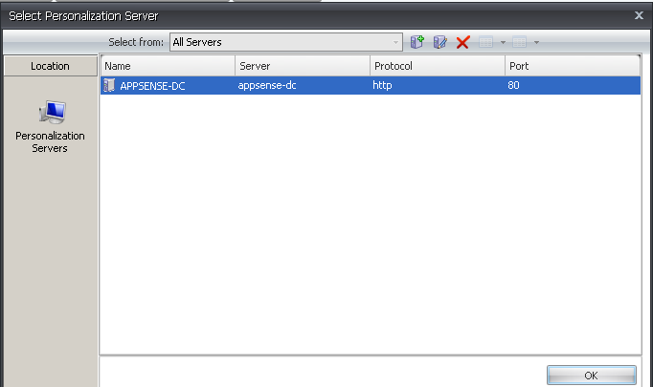
Personalisation
Confirm you have enabled the Personalization Server in the Policy side of the configuration

Slide 79
Confirm you have at least one site

Slide 80
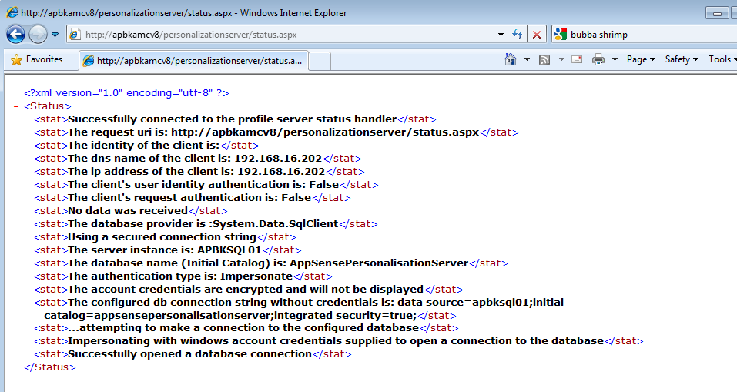
How to test the Personalisation Server Connection
http://machinename/personalizationserver/status.aspx

Slide 81
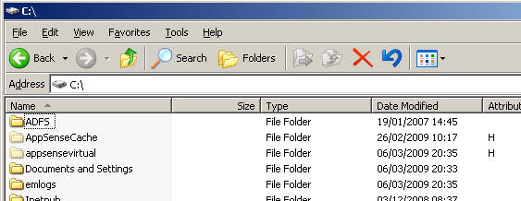
How to test the Personalisation Server Connection
Check the client machine and look for the ProfileConfig.XML
C:\AppSenseCache\SID\ProfileConfig.XML

Slide 82
Check the PVC has loaded..

Slide 83
Architecture and Scalability

Slide 84
AppSense Management Console
AppSense Management Centre
Used to deploy agents and configs
Updates to configurations
Control different groups of machines
Configuration version control
Centralised Auditing

Slide 85
AMC Sizing
AppSense Management Centre
Agent typically between 5 – 10MB
Configuration typically apx 500KB
Average DB size apx 5 – 10GB for 10,000 users / 500 servers
Single AMC can support apx 5000 connections (machines)~
N+1 should be used for fault tolerance
AMC supports Windows Network Load Balancing

Slide 86
Personalisation Server
Used to “stream” profile information down to client machine on application start
Streams the files and registry settings needed by the application
On application close, the settings are streamed back to the server and stored in the database
PS Communication Diagram.....

Slide 87
Personalisation Server Sizing
AppSense Environment Manager
Typical Profile Size 3 – 5MB per user
Default 5 profile snapshot per user
Data is compressed for the PS Server and DB
2000 users
2000 x 5MB = 10 GB
10GB x 5 snapshots = 50GB
Single PS can support apx 7000 connections per CORE!
N+1 should be used for fault tolerance
PS supports Windows Network Load Balancing

Slide 88
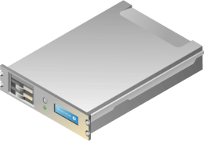
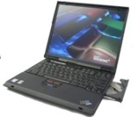
V8 Architecture – Management Communication
V8 Architecture – Personalization Communication
Management Server Database (SQL)
CCA
The EM Agent has got a local configuration installed for Policy – delivered by the CCA
In addition to this, a personalisation configuration is downloaded from the Personilization server every 5 minutes and at logon / logoff
When the user logs on, logs off, starts applications, closes applications, the profile for that User and ONLY that Application is downloaded from the Database via the PS server
RDP/ICA
EM
HTTP(S)
Virtual Desktops Hypervisor Independent
Thin Clients
AppSense Management Server W2K3/W2K8 with IIS
HTTP(S)
CCA
EM
HTTP(S)
CCA polls the AppSense Management Server based on a poll period and at machine start up.
CCA communicates via HTTP or HTTPS.
CCA in charge of downloading Agents and configurations via BITS
CCA also responsible for uploading Auditing events from the other products.
Agents, Configurations and auditing events are all stored in DB
HTTP(S)
Fat Client Desktop
HTTP(S)
AppSense Personalization Server W2K3/W2K8 with IIS
CCA
HTTP(S)
EM
Personalisation Database (SQL)
Fat Client Laptops

Slide 89
V8 Architecture – Summary
CCA
Management Server Database (SQL)
RDP/ICA
EM
HTTP(S)
Virtual Desktops Hypervisor Independent
Thin Clients
AppSense Management Server W2K3/W2K8 with IIS
HTTP(S)
CCA
EM
HTTP(S)
HTTP(S)
Fat Client Desktop
HTTP(S)
AppSense Personalization Server W2K3/W2K8 with IIS
CCA
HTTP(S)
EM
Personalisation Database (SQL)
Fat Client Laptops

Slide 90
V8 Architecture – DB Scalability
CCA
Management Server Database (SQL)
RDP/ICA
EM
HTTP(S)
Virtual Desktops Hypervisor Independent
Thin Clients
AppSense Management Server W2K3/W2K8 with IIS
HTTP(S)
SQL Clusters
CCA
EM
HTTP(S)
HTTP(S)
Fat Client Desktop
HTTP(S)
AppSense Personalization Server W2K3/W2K8 with IIS
CCA
HTTP(S)
EM
Personalisation Database (SQL)
Fat Client Laptops

Slide 91
V8 Architecture – AMC and PS Server Scalability
CCA
Management Server Database (SQL)
RDP/ICA
EM
Windows Load Balancing
HTTP(S)
Virtual Desktops Hypervisor Independent
Thin Clients
AppSense Management Server W2K3/W2K8 with IIS
HTTP(S)
SQL Clusters
CCA
EM
HTTP(S)
HTTP(S)
Fat Client Desktop
Windows Load Balancing
HTTP(S)
CCA
HTTP(S)
EM
Personalisation Database (SQL)
AppSense Personalization Server W2K3/W2K8 with IIS
Fat Client Laptops

Slide 92
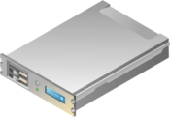
V8 Architecture – Failover / Proxy / MultiSite
CCA
Windows Load Balancing
Management Server Database (SQL)
RDP/ICA
EM
Virtual Desktops Hypervisor Independent
AppSense Management Server
Windows Load Balancing
Thin Clients
Site 1
CCA
AppSense Personalization Server
SQL Clusters
EM
Windows Load Balancing
Fat Client Desktop
CCA
Windows Load Balancing
AppSense Management Server
HTTP(S)
EM
Personalisation Database (SQL)
Site 2
Fat Client Laptops
AppSense Personalization Server

Slide 93
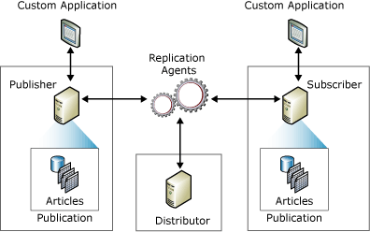
PS Database Replication
Used in multi site environments
Allows users to roam
Uses sequel “merge” replication
One becomes the “publisher,”
Others become subscribers
In the event of conflict the publisher wins
Snapshots are not replicated

Slide 94
PS Database Replication
Two publications are made available by the master:
1. Config- all the configuration data (ie. data set up by the console). The merge agent runs every 5 minutes
2. Data: The actual personalization data (users and application settings). The merge agent runs daily at midnight.
Subscriptions to these publications are set up for each slave.
These are “updatable push merge”
subscriptions.
This means data from the publisher is merged with data on the subscriber, updates made on the subscriber are propagated back to the publisher, and the subscription agent runs on the publisher (hence “push”).
Data transferred consists only of changes made, so slaves must be initialized from a snapshot stored on the publisher.
A “Synchronize Site Databases” button is provided which runs the stored procedure “ForceReplicationNow”.

Slide 95
PS Database Replication
Scripts found....
c:\Program Files\AppSense\Environment Manager\Personalization Server\Replication\
SQL Replication Best Practice Doc

Slide 96
AppSense in Streamed OS

Slide 97
Citrix Provisioning Server
Installation of most agents cause a reboot
No good in CPS environment
Agents must be installed in “Private” mode
Need to install all agents – not just the CCA
No Need to install the configs *
Once the vDisk is in READ ONLY the machine will start with all agents installed and contact the AMC

Slide 98
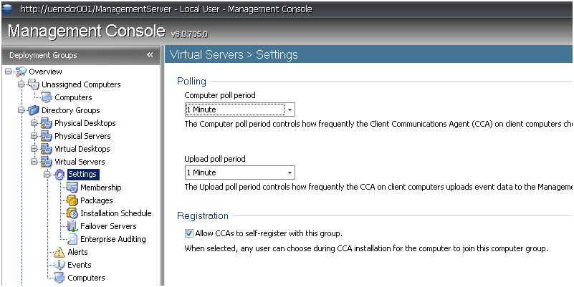
Citrix Provisioning Server
Must allow CCA to self register

Slide 99
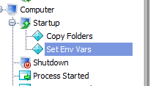
Citrix Provisioning Server
The agents will not download as they are already present
Check Add/Remove Programs
All configs for the group will be downloaded
* If EM Start Up Actions are being used then the EM config MUST be installed when the vdisk is in private mode!

Slide 100
Citrix Provisioning Server
When using Computer groups machines will not self register
CCA only registers when installing
Machines can be pre listed or....
Use RE – ARM vb script......(see best practice doc)
net stop "AppSense Client Communications Agent"
REG DELETE "HKLM\SOFTWARE\AppSense Technologies\Communications Agent" /v "machine id" /f
REG DELETE "HKLM\SOFTWARE\AppSense Technologies\Communications Agent" /v "group id" /f
REG ADD "HKLM\SOFTWARE\AppSense Technologies\Communications Agent" /v "self register" /d "GroupName"

Slide 101
Using Personalisation with Streamed Applications

Slide 102
Streamed Apps
Natively installed
Symantec SVS
Microsoft App V
Citrix Streaming
Coming Soon...
ThinApp *
Installfree

Slide 103
SVS
In EM exclude C:\fsldr (the SVS file cache)
In EM make sure you are matching firefox by filename only, not full path - in SVS it is executed from C:\fsldr\...
In the SVS layer, exclude:
C:\appsensevirtual (and subdir's)
AppData (and subdir's)
LocalAppData (and subdir's)

Slide 104
App V
Navigate to Microsoft Application Virtualization Sequencer.
Open the required Application Package.
Select Tools > Options.
The Options dialog box displays.
Select the Exclusion Items tab.
Click New.
The Exclusion Item dialog box displays.
In the Exclude Path enter C:\AppSenseVirtual.
Select the Mapping Type VFS.
Click OK.
The main package screen is re-displayed, click OK.
10. Save the Package.
11. Repeat for each Application Package as required.

Slide 105
Citrix Streamed Apps
For relaxed security: - All named pipes need to be added to the streaming profile.
Right click the target i.e. Windows Server 2003 [All service packs], select properties
Select “Rules” tab
Add, select Ignore and Named Objects, Next
Select All Named Objects, Next
Rule Name should read “Ignore All named objects2
Select Finish.
For enhanced security: - All named pipes need to be added to the streaming profile and the AppSense virtual cache.
Repeat the above steps to “Ignore All named objects”.
Right click the target i.e. Windows Server 2003 [All service packs], select properties
Select “Rules” tab
Add, select Ignore and Files and Folders, Next
Add, type c:\appsensevirtual, ok
Next
Rule Name should read “Ignore c:\appsensevirtual”
Select Finish
StreamingPersonalization.avi

Slide 106
AppSense Performance Manager

Slide 107
Performance Manager – Default Configuration
From a new template
Smart Scheduling Enabled
Thread Throttling Enabled
Physical Memory Control Enabled
DLL Optimization Enabled
Statistics Disabled
CPU Hard and Soft limits disabled
Physical and Virtual Memory Limits disabled
Disk Control Disabled

Slide 108
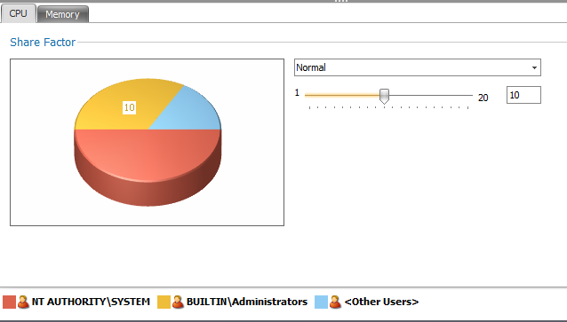
Smart Scheduling
In most cases these share factors do not need changing
System Processes get 3 x Share
Administrators 2 x Share
Users 1 x Share

Slide 109
Smart Scheduling
Users additionally get Share factors based on session state
Normal 2 x Share for application in foreground, connect etc
Desktop locked ½ share
Disconnected Session ½ share

Slide 110
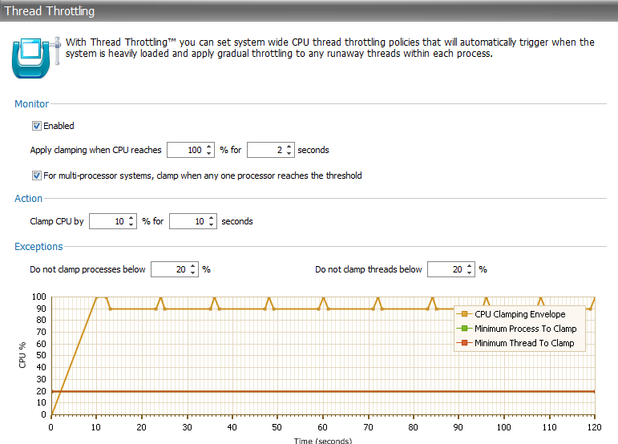
Thread Throttling
Default TT enabled when CPU hits 100% for more than 2 seconds
Make sure that Multi CPU is enabled
Always clamp by 10 or 20%
Make TT more aggressive by changing the MIN PROC and MIN THREAD to clamp
Good for test scripts

Slide 111
DLL Optimization - Analysis
Default is 60 mins
Set this to 120 mins once DLL has been found
Less CPU activity during the day
Still finds most DLL within 3 days

Slide 112
DLL Optimization - Optimization
Optimize copies the files to the APPSENSECACHE
Cache is same drive as Application
Network Cache is AppSenseCacheN
Good practice to set this to “Out of Hours”
Include Signed Components
Include Network Components
Not many Applications need excluding - .NET done already
Don’t forget to CLEAN DLL which may of been optimized by Citrix DLL Optimization

Slide 113
Feature Options
Use Feature options to quickly disable parts of Performance Manager you don’t need
Disable Thread Throttling and DLL optimization for SYSTEM BASED processes

Slide 114
Session Idle Time Out
Time Out useful when using CPU or Memory Control based on IDLE
IDLE time IS NOT CITRIX or MS session idle timeout – its PM Idle time
Setting to 7 mins (from 15) will make memory trimming and CPU SS more aggressive

Slide 115
AppSense Performance Manager 8.0 SP2
New in SP2
Excluded Processes from TT or SS
Used on all customers using Symantec Anti Tamper – v9 +

Slide 116
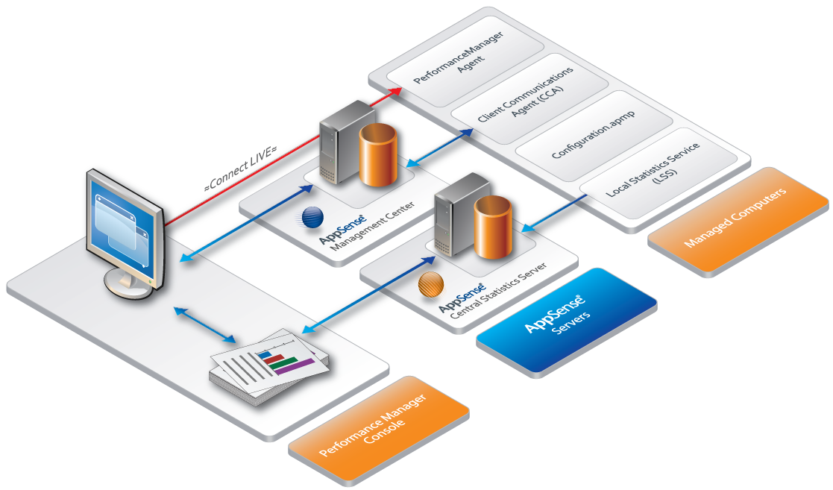
Statistics
Collecting Stats needs both the PM agent, a working configuration and the Local Stats Agent to be installed on target machine
Performance Manager can be in passive or live mode

Slide 117
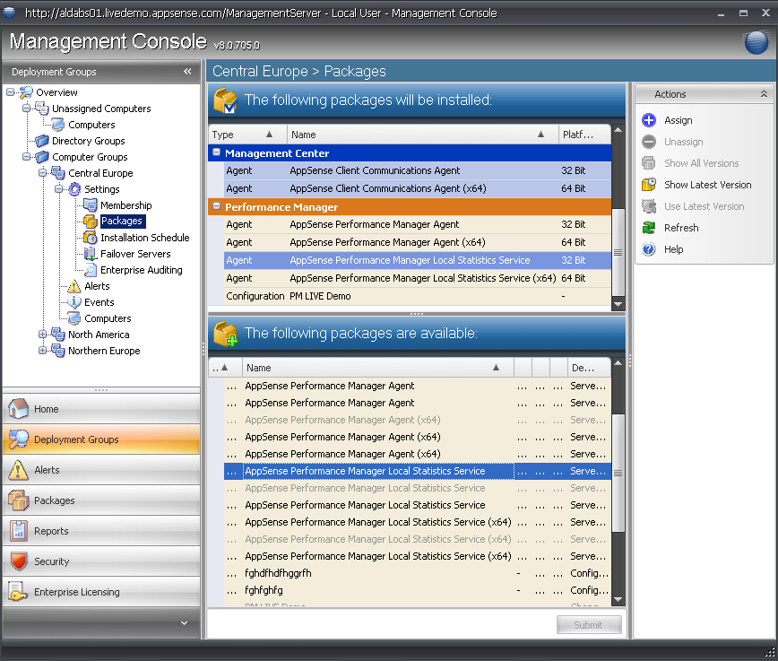
Adding the LSS

Slide 118
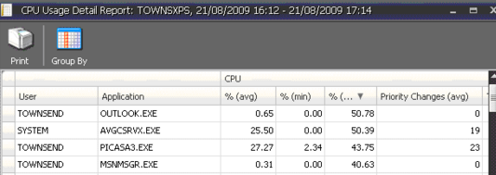
Statistics - Reporting

Slide 119
Collecting Stats
User | Process | Collection Level = High
User01 | Winword.exe | All 5 seconds a record for that unique process for that unique user in the LSS db.
 | Excel.exe | All 5 seconds a record for that unique process for that unique user in the LSS db.
User02 | Excel.exe | All 5 seconds a record for that unique process for that unique user in the LSS db.
 | Access.exe | All 5 seconds a record for that unique process for that unique user in the LSS db.

Slide 120
Stats Collection
Off (default) – the Statistics Collection node in the navigation tree is grayed out when the Statistics Collection setting is off and the LSS service is stopped in this mode. For all other modes the LSS will be started by the Performance Manager Agent.
Low – machine wide every 5 seconds and every 15 minutes an Application Group summary from a sample rate of 5 seconds.
Medium – as Low, but every 15 minutes a per process, per user summary is generated from a sample rate of 5 seconds.
High – as Medium, but every 5 seconds a per process, per user actual statistic values are recorded. This is the most accurate way of recording statistics, but the most expensive.

Slide 121
Questions ?

Slide 122
AppSense Application Manager

Slide 123
Default Configurations
\\CD Image\Software\Products\Templates\EN
English and German AM “Passive mode”
English and German AM “active mode”
Only allows executables from Local Drive
Network Apps blocked by default
Only allow executables owned by Trusted Owners

Slide 124
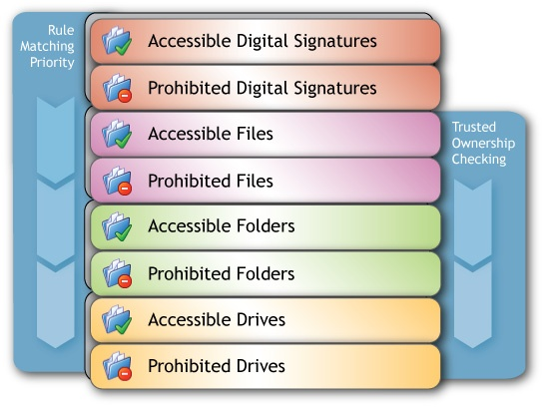
What wins?

Slide 125
Trusted Owners in Windows Desktop vs Server.
Default owner is the person who “introduced” (installed) the file(s)
Eg: Office installed by x is owned by x.....
In Windows 2003/2008, by default, the owner is set to the group the installer belongs to.
Eg: SimonT is a member of the Administrators group.
NTFS ownership of files is set to Administrators
In Windows XP and Vista, by default, the owner is the account actually logged on, not the group
SimonT is a member of the Domain Admins
SimonT is the owner of all files he installs
Users can not run files installed by SimonT as the default config doesnt have SimonT listed as a trusted owner

Slide 126
Trusted Owners
In Desktop environment, either add SimonT to the Trusted Owners or
Change GPO
Computer Configuration > Windows Settings > Local Policies > Security Options > System Objects > Default Owner for objects

Slide 127
Best Practice
Add Network Based Applications as Accessible items
Use folders for ease of use
Turn off NTFS checks on non NTFS shares
Use SHA #1 Signature checks on non NTFS drives
Ignore restrictions during logon to allow logon scripts to run
Use Passive mode for a week trail
Use the AM Rules analyser to find out why execuatables are allowed / blocked.

Slide 128
Application Manager – ANAC
Application Network Access Control

Slide 129
Application Network Access Control
What is ANAC?
The ability to control the Network access of a User, Group, Device or on the outcome of a script.
What can it control?
99% of items that use the Winsock layer
Access to Servers by name or by their IP address
Access to ports
Access to urls (Designed for internal urls only)
Combinations of Host name/IP & port
What can’t it control?
Items that create their own packets (cmd.exe ping command)
Items that operate at a lower level than the winsock layer
Drivers that access Network traffic
SVC host and AM components are exempt from control among others
Outlook comms to exchange
Company Confidential
Notes:
The ability to control the outbound Network access of a User, Group, Device or on the outcome of a script.
SVCHost is not the only process there are many, the current list is:
AM components:
AMAgent.exe
AMAgentAssist.exe
AMMessage.exe
AMMessageAssist.exe
AMTimeLimits.exe
AMAppLimits.exe
AMZip.exe
CCA components:
CCA.exe
Debuggers:
windbg.exe
cbd.exe
ntsd.exe
kd.exe
drwtsn32.exe
Specific Windows components:
svchost.exe
SLsvc.exe
SLUI.exe
Lsass.exe
Outlook comms is an example of RPC. I don’t think we currently control RPC but more testing is required.

Slide 130
ANAC How it works
Components
Hooking Mechanism
Redirection Engine
ANAC.dll
Mini filter driver
AM agent
What happens for URLS, IPs and host names
Our hook, hooks in to applications when they start and injects our ANAC.dll
When the application tries to access the network we re-direct to our AM agent. To allow or deny access to the Network location
Company Confidential
Notes:
I think the use of the word redirection is misleading – I know you mean detours but in AM we use redirection to explain blocking apps to the message box.
I think a new term is required, or it is skipped over and is bundled in with the hook dll. If you want to use the redirection term then I you need to be careful about confusing the reader.
We may use the redirection term in ANAC to talk about ‘web page redirection’ on a blocked web page so the user gets some feedback.
Our hook, hooks in to applications when they start and injects our ANAC.dll – not true.
There are several ways that our hook dll is injected into the application depending on the state of the agent.
1. By the remote thread injection method.
2. By AppInit_Dll registry key method.
This important this is that there is a hook and it is in the application and intercepts any calls the application makes to the winsock library.
During this interception AM evaluates the call the application made and depending on the configuration either allows the application to make the call to the winsock layer or if denied we return an error to the application.
Important note: We return an error back to the calling application, it is up to the application to handle the error correctly. Some applications may not handle the error correctly and crash, or hang or wait for a timeout. This is not the fault of our hook or AM, it is because of crappy developers.

Slide 131
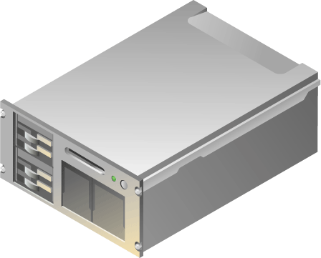
Why use ANAC?
To Control where a user can go if external?
LAN
Company Confidential

Slide 132
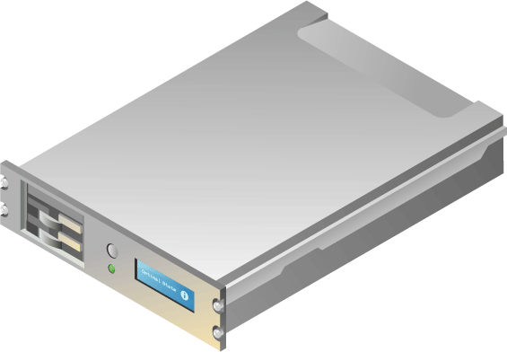
Role Based Network Access
Finance
Engineering
Company Confidential

Slide 133
ANAC How it works
Telnet.exe
TCP/IP
192.168.70.1:80
RDE
Allow?
ANAC DLL
Agent
Per App result store
Deny!
WINSOCK
Company Confidential
Notes:
Speaks for itself

Slide 134
ANAC how to use, Controlling IPs
IP Address Radio Button
The IP of the console machine by default currently
Ports left blank
This default will block complete access to this IP if added to a prohibited item
Company Confidential
Notes:
I would give a real world example rather than the default – the inclusion of the host’s IP address I still think is confusing.

Slide 135
ANAC how to use, Controlling host names
Host Name Radio Button
The IP of the console machine by default
The server name needs to be added
Ports left blank
This default will block complete access to this host if added to a prohibited item
Company Confidential

Slide 136
ANAC how to use, Controlling access to UNCs
Network share Radio Button
The IP of the console machine by default
Ports greyed out
Enables the ability to add the path you want control
This default will block complete access to this IP if added to a prohibited item
Company Confidential
Notes:
This will not block access to the root of the server (see case 16106) unless the include subdirectories is ticked. Technical restrictions explain in the case notes.
ANAC can’t allow if blocked already with NTFS security

Slide 137
ANAC how to use, Controlling access to URLs
Host Name Radio Button
The IP of the console machine by default
However the host will need to be added
URL path can be entered in the host section
And will automatically be moved to this location
This will block access to the appsense phone list if placed in a prohibited rule
Company Confidential

Slide 138
Things to be aware of
Specifying *.*.*.* for an Blanket block for everyone
Will block all outbound network traffic and will force you to add everything that that needs network access to function we will be adding 0.0.0.0 as part of SP2
Blocking applies to the user, not things that run as system
Reverse DNS lookups are turned off by default
An engineering key exists to turn on if needed for local
Controlling Internet traffic will have a negative impact on performance
An accessible rule will override a denied rule of the same type
Think of host an IP addresses in the same way as files folder rules and paths as file rules
Company Confidential
Notes:
CCA is an exempt application and as such should not be blocked in any circumstances. Even if it was hook it is running as system (although to communicate to the Management Server it may use impersonation). If you believe this is the case then it needs reproducing and a bug raised. Where did this ‘rumour’ come from?
Explanation of what RDNS gives us and the pitfalls of using it – especially with internet. Information about configuring it is in the engineering doc.
Controlling internet traffic will have a negative impact on performance – not in the same way it used to. The RDNS has been removed by default and this was the major problem.
The other possible slow down is caused by the DNS lookups – but this has to be done anyway by the application. Once done though the results are cached. This is done for ALL requests not just local IP ranges. So you would be seeing this slow down right now if it was there.
Rule order...
Just like our current rules.
Think of host and IP addresses as folders and path components as files.
Real world example:
Note that there is a slight delay between saving the configuration and the rules being applied in IE – this is normal the configuration changes need to trickle down to all the running applications.
Block access to everything *.*.*.*
Allow access to the appsense intranet: hostname: intranet
Allow access to DNS servers if required.
In IE go to http://intranet navigation is allowed to various parts of the site but not to ‘Office Info’
So allow access to apwasp01
Navigate to the office info page.
On this page there is a link to a word document. Lets say we don’t want someone downloading this word doc.
We assume that all word documents have the extension doc or docx.
Add a rule to block all word doc from apwasp01: hostname apwasp01, path:/sites/bigred/documents/Documents/Corporate/Policy/ConfFacilityGuide_25_01_08.doc
We can actually past the whole url: http://apwasp01/sites/bigred/documents/Documents/Corporate/Policy/ConfFacilityGuide_25_01_08.doc into the hostname text box and it will sort it out for us.
Attempts to download are blocked.
Link wise we can allow access to only one area of the site...
Remove the rules we have added
Deny: intranet
Allow http://apwawp01/?cat=5
You can now only see Charlie’s blog by going there directly.
Next block apwawp01 – this is were the pictures and CSS live
This site looks bad!
Add allow to: http://apwawp01/includes/css/main.css
This formats the page, but with no pictures.
Add allow: http://apwawp01/wp-content/uploads/* (tick the wildcard chars)
No examples with port here I will leave to you do that!

Slide 139
Best Practises
Try to limit the use of wildcard *
Limit use for controlling external web access
Make sure thatTurn off the reverse DNS look up for internal web sites/web applications
HKLM\software\AppSense Technologies\Application Manager\MessageConfig\Engineering
Try not to mix different types of network connection
If you have blocked all urls in your blacklist then you should allow the same type in your white list
Company Confidential
Notes:
Wildcards are OK really, it isn’t the best solution cause you can easily get confused. If you know what you are doing though then they are OK.
The issues come with have a lot (like using it for web filtering) of rules. The more rules the slower AM gets! Typical web filtering products will have million of urls and are optimized to handle this type of volume. AM is not.
The use of RDNS is not required if you are configuring using IP addresses only.
Mixing types of URLs is fine if you know what you are doing!

Slide 140
Questions ?

Slide 141
AOB

Slide 142
Other Resources...
AppSense Blogs
http://www.appsense.com/community/
Updated daily by Marketing, pre sales, support, product managers
Videos
www.appsense.com/media
AppSense Consultant – Jon Wallace (MVP)
www.insidetheregistry.com
AppSense Pre Sales / System Engineering
RoWPreSales@AppSense.com
AppSense un official forums
http://www.apug.info/

